Slide 1
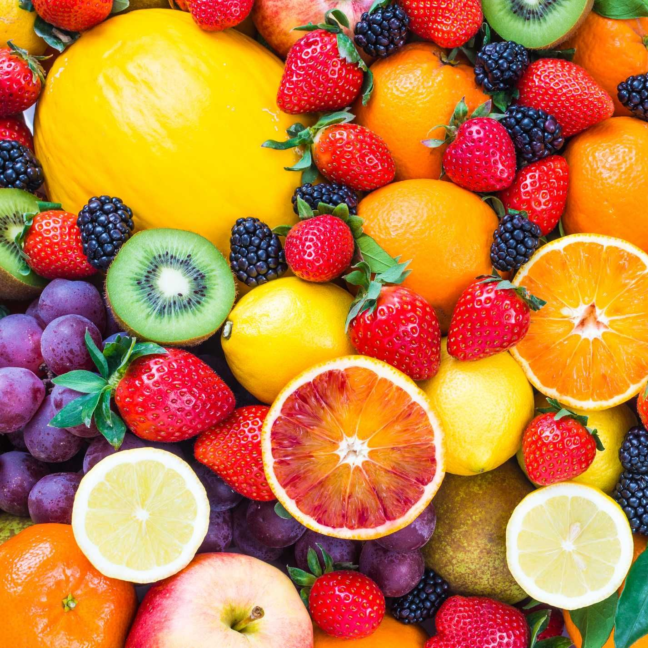

Team 2: Robotic Sorting System
Bi-Weekly Update 2 Pace Dominy, Joseph Miller, Lam Tran Sponsor: Dalton Cyr TA: Swarnabha Roy
Notes:
Michelle

Slide 2

Project Description
Sorting fruit by hand can be tedious and expensive.
The Robotic Sorting System is an automatic sorting system that requires limited manpower/oversight that can accurately sort fruit by their size and quality without the user having to do it themselves.
Notes:
Sorting fruit by hand can be tedious and expensive
The Robotic Sorting System provides a relatively inexpensive way to accomplish the task
It optically scans the fruit to determine its size and color
Then puts it in a bin as specified by the machine configuration
It’s particularly useful for cost-limited or near-end-user applications where you don’t want/can’t afford something huge and expensive.

Slide 3
System Diagram
Maroon arrows denote physical inputs and outputs
Operator Input
Fruits
Android Application
System Status
Conveyor Belt
Joseph Miller
Sorting Configuration
Control
Sensors
Data
Raspberry Pi
Fruits
Data
Robotic Levers
Fruit Receptacles
Lam Tran
Power Control
Provides power to all subsystems except Android application
Pace Dominy
Pace Dominy
Wall Power
Notes:
All configuration and system status is displayed via an Android application
The sensors and Android app connect to a Raspberry Pi that pushes configuration to the robotic levers
Wall power is standard U.S. 120V 60Hz mains power

Slide 4
Project Timeline
Finished Android Application subsystem (completed 2/5) | Finished Sensor subsystem (completed 2/12) | Power Control System (to complete by 2/12) | Final Integration of Android App connection (to complete by 2/25) | Finish basic Robotic Sorting System functionality (to complete by 3/7) | All subsystems integrated (to complete by 4/9) | Final Project Demonstration (to complete by 4/24)
Notes:
Here is our project tiem line time line (30 sec)
-- Save discussion for subsystem update
-- Save detail for execution plan & validation plan status
Target or actual dates within or above boxes – green done, yellow underway, red in trouble, white not started

Slide 5
Subsystem 1, Android Application
Joseph Miller
Accomplishments since Status Update 1 (19 hours of effort) | Ongoing progress/problems and plans until the next presentation
Expanded Bluetooth read/writes to > 1 byte using a standard format Added loading screens and input limits to prevent faulty configuration Completes subsystem-level validation plan Added conveyor belt control system with corresponding screen Migrated from Material 2 “default” UI to Material 3 custom UI | Install Bluetooth server on the RSS Raspberry Pi Determine how the data from the weight sensors and the configuration of the guiding arm logic can be exposed to the Bluetooth server
Notes:
New Bluetooth format: 1 configuration byte → byte array with [configuration type, cutoff 1, cutoff 2, belt control bit]. 1 weight byte is largely the same: it doesn’t need to be changed for the weight values we’re looking at
New BT format maximizes “options” for integration depending on the needs of other subsystems: can even extend the array if needed to carry more information
Loading screens/input limits minimize ways to break the other subsystems
For 2nd review should all be in the context of your integration plans! For example:
“Completed X-function in preparation for integrating with Y-subsystem”
“Tested integrated motor controllers with MCU by verifying full range of motion on all 6 joints with no load and 0.5kg load”
“On-going integration of motor control system with MCU”
“By next review will integrate with android app”

Slide 6
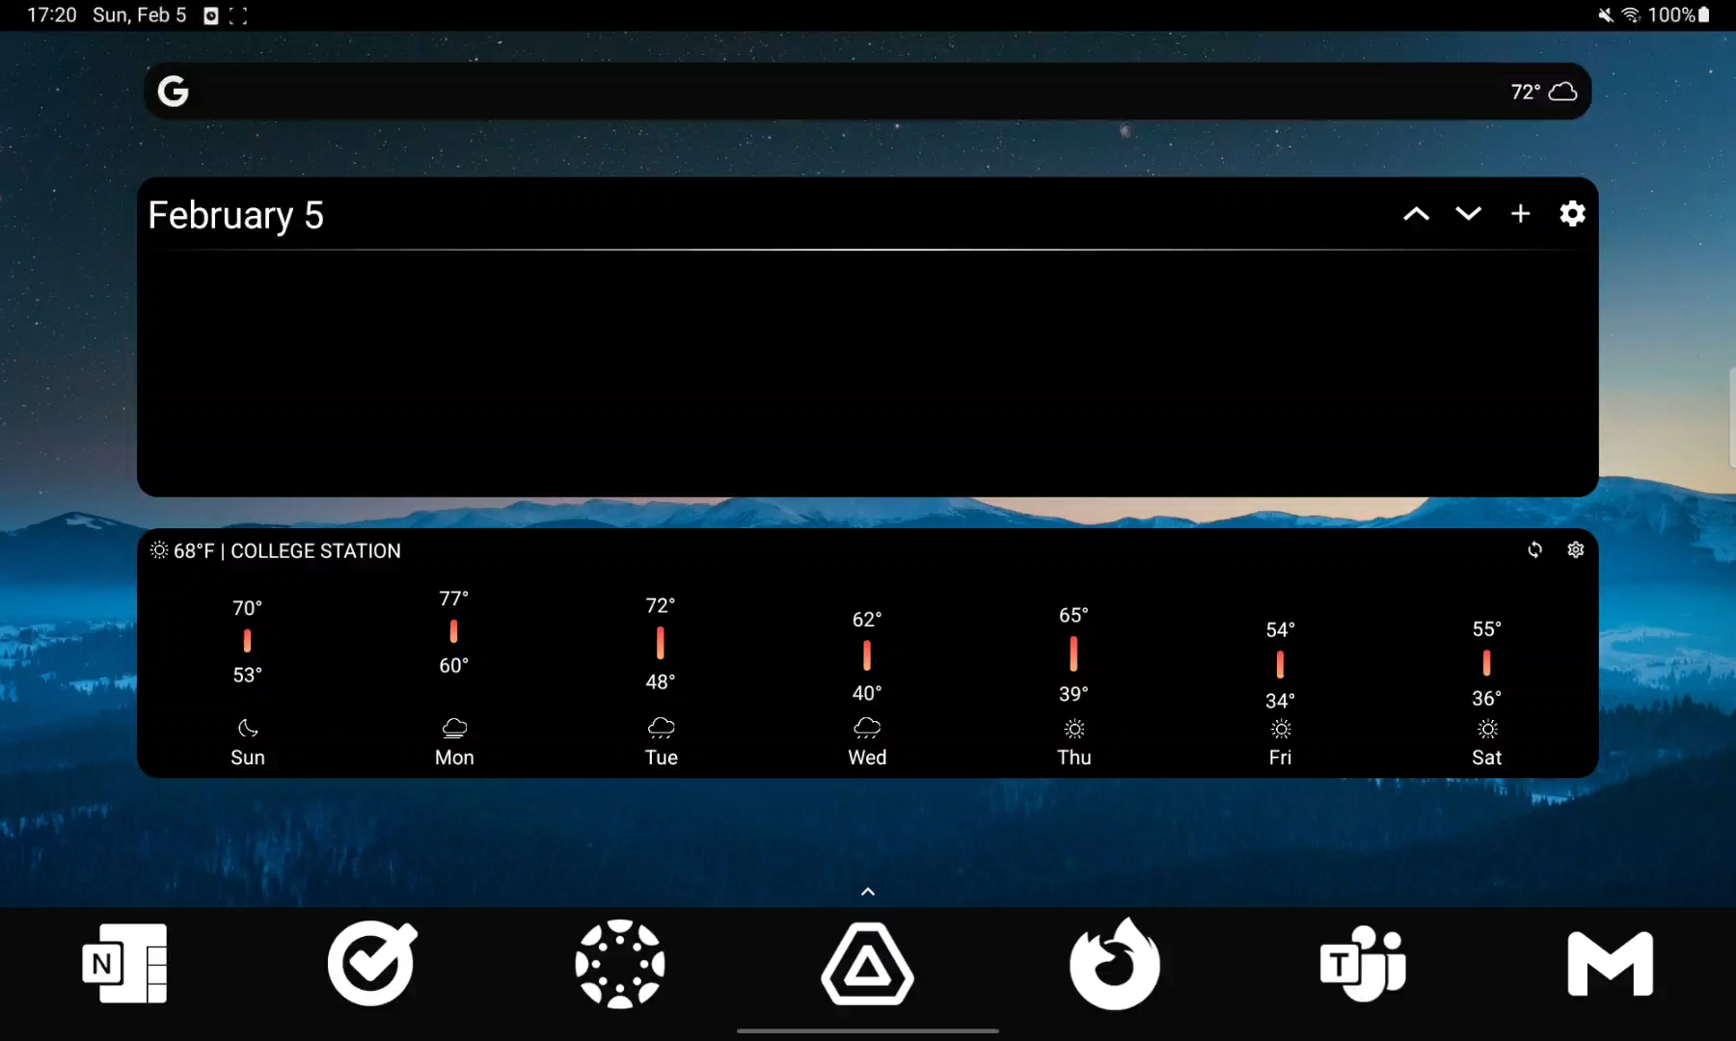
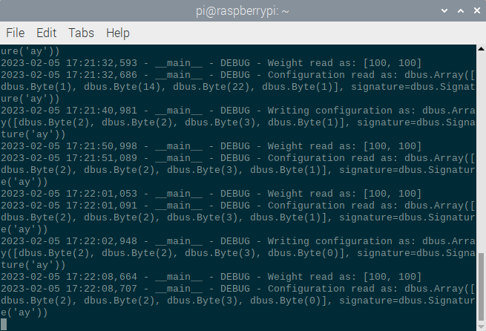
Subsystem 1, Android Application
Notes:
Key things to note:
New UI makes the app more appealing (and has a dark mode version)
Machine Info screen is much easier to read
Belt read screen has been added
Configuration gate: trying to apply 2 colors doesn’t work
Note the ByteArrays in the BLE terminal output on the bottom

Slide 7
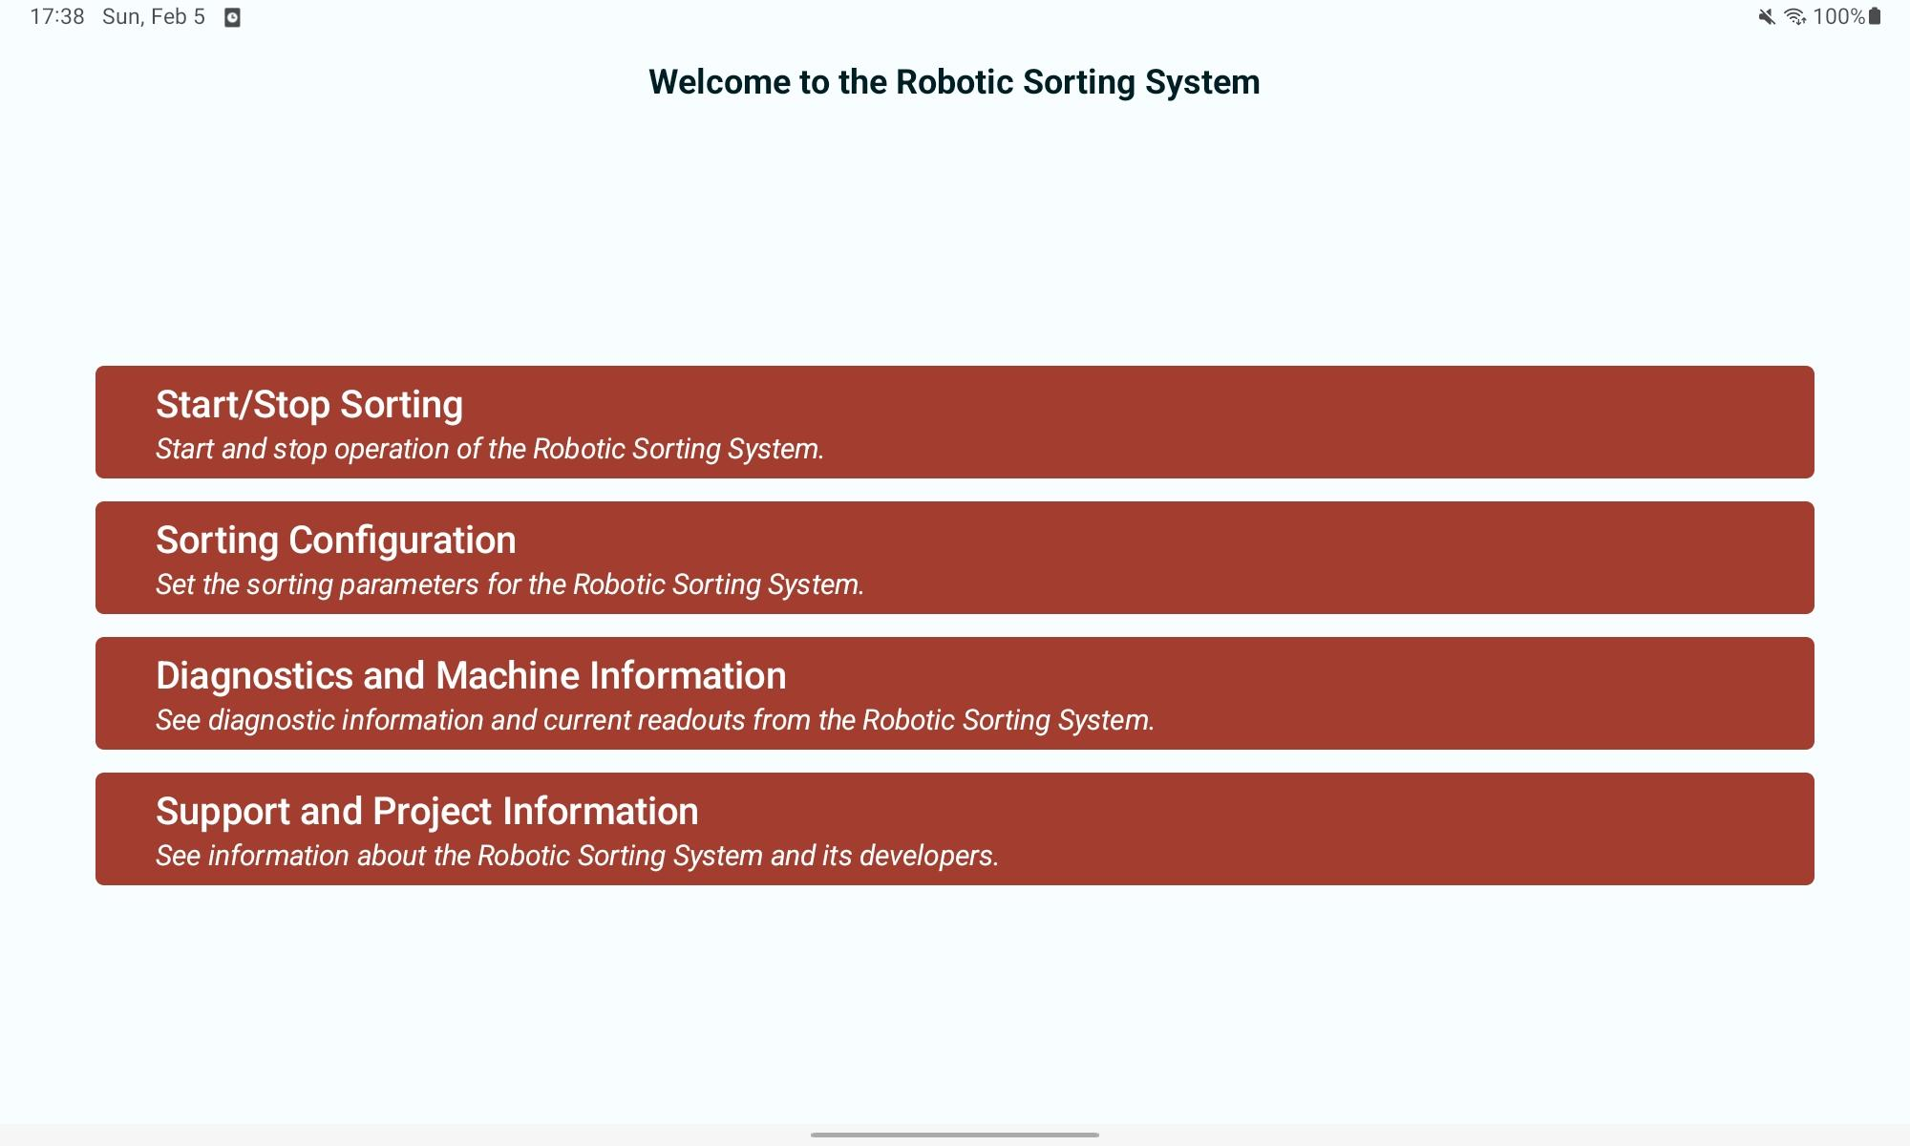
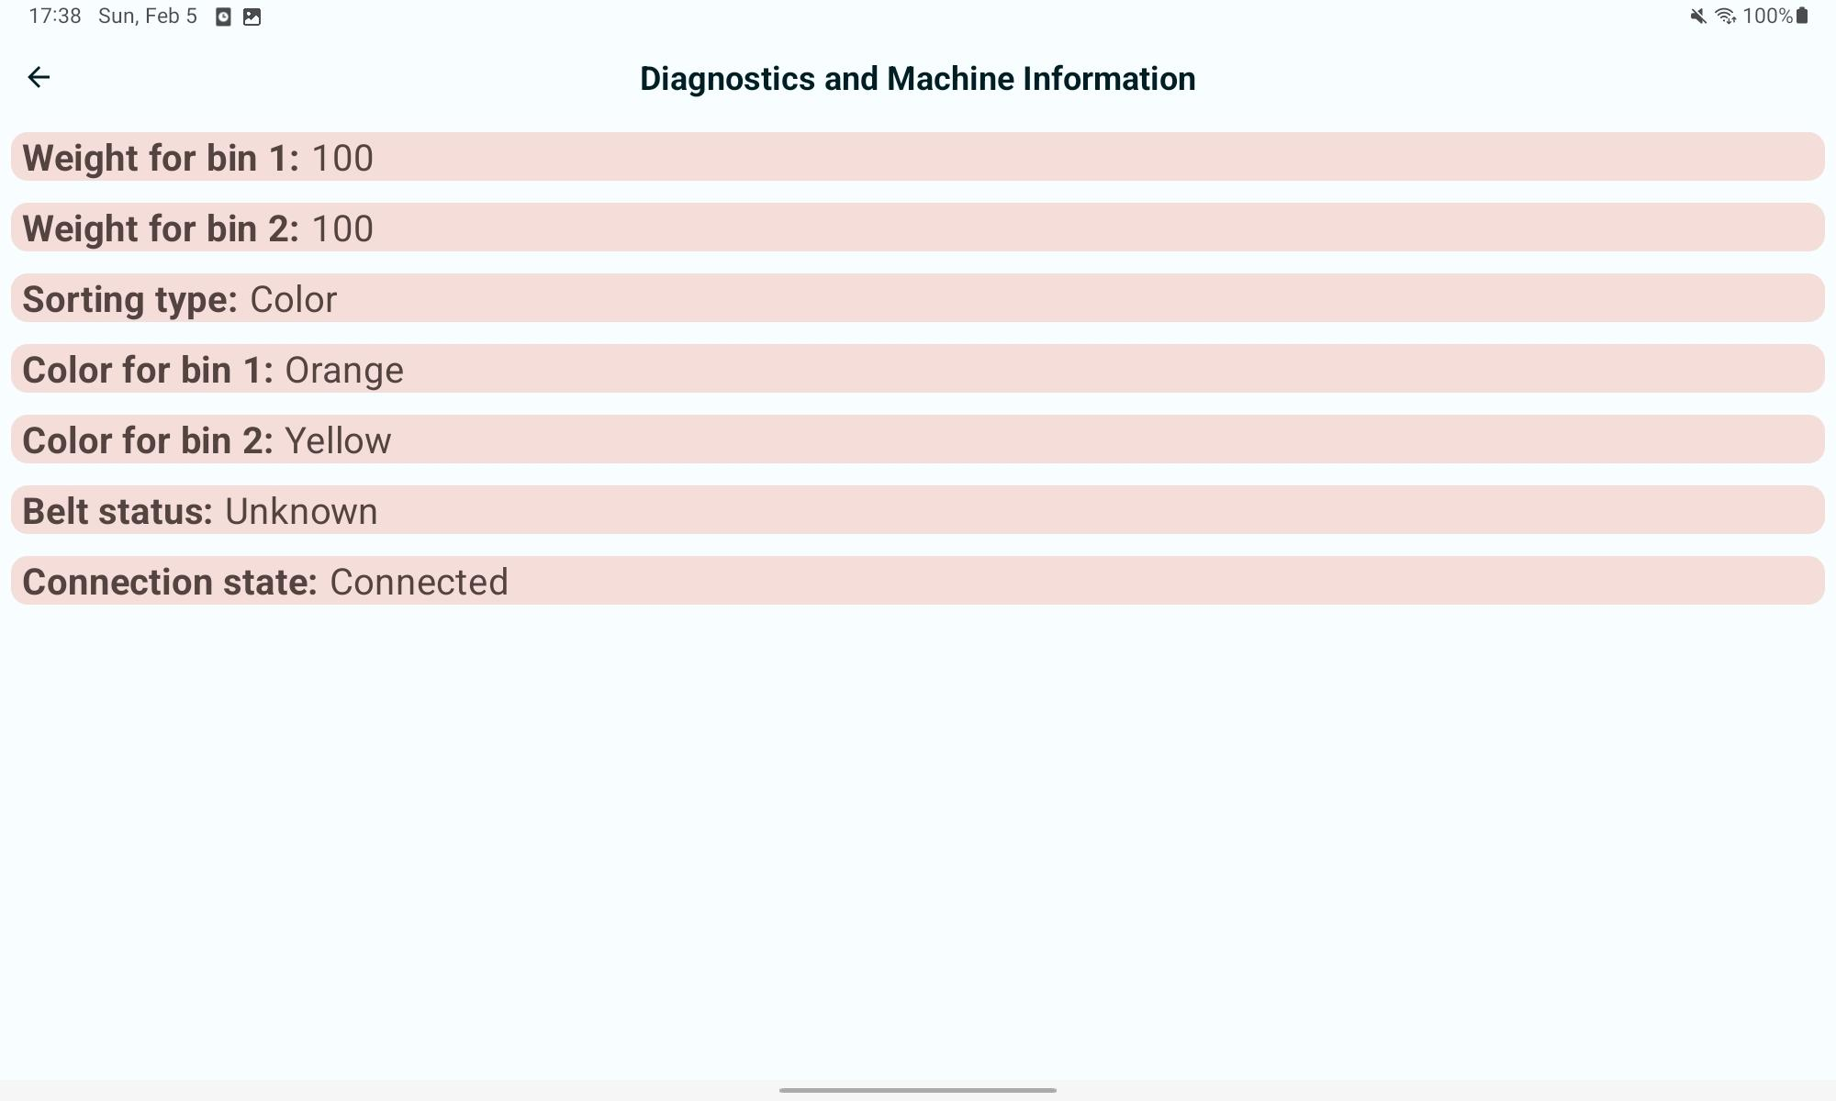
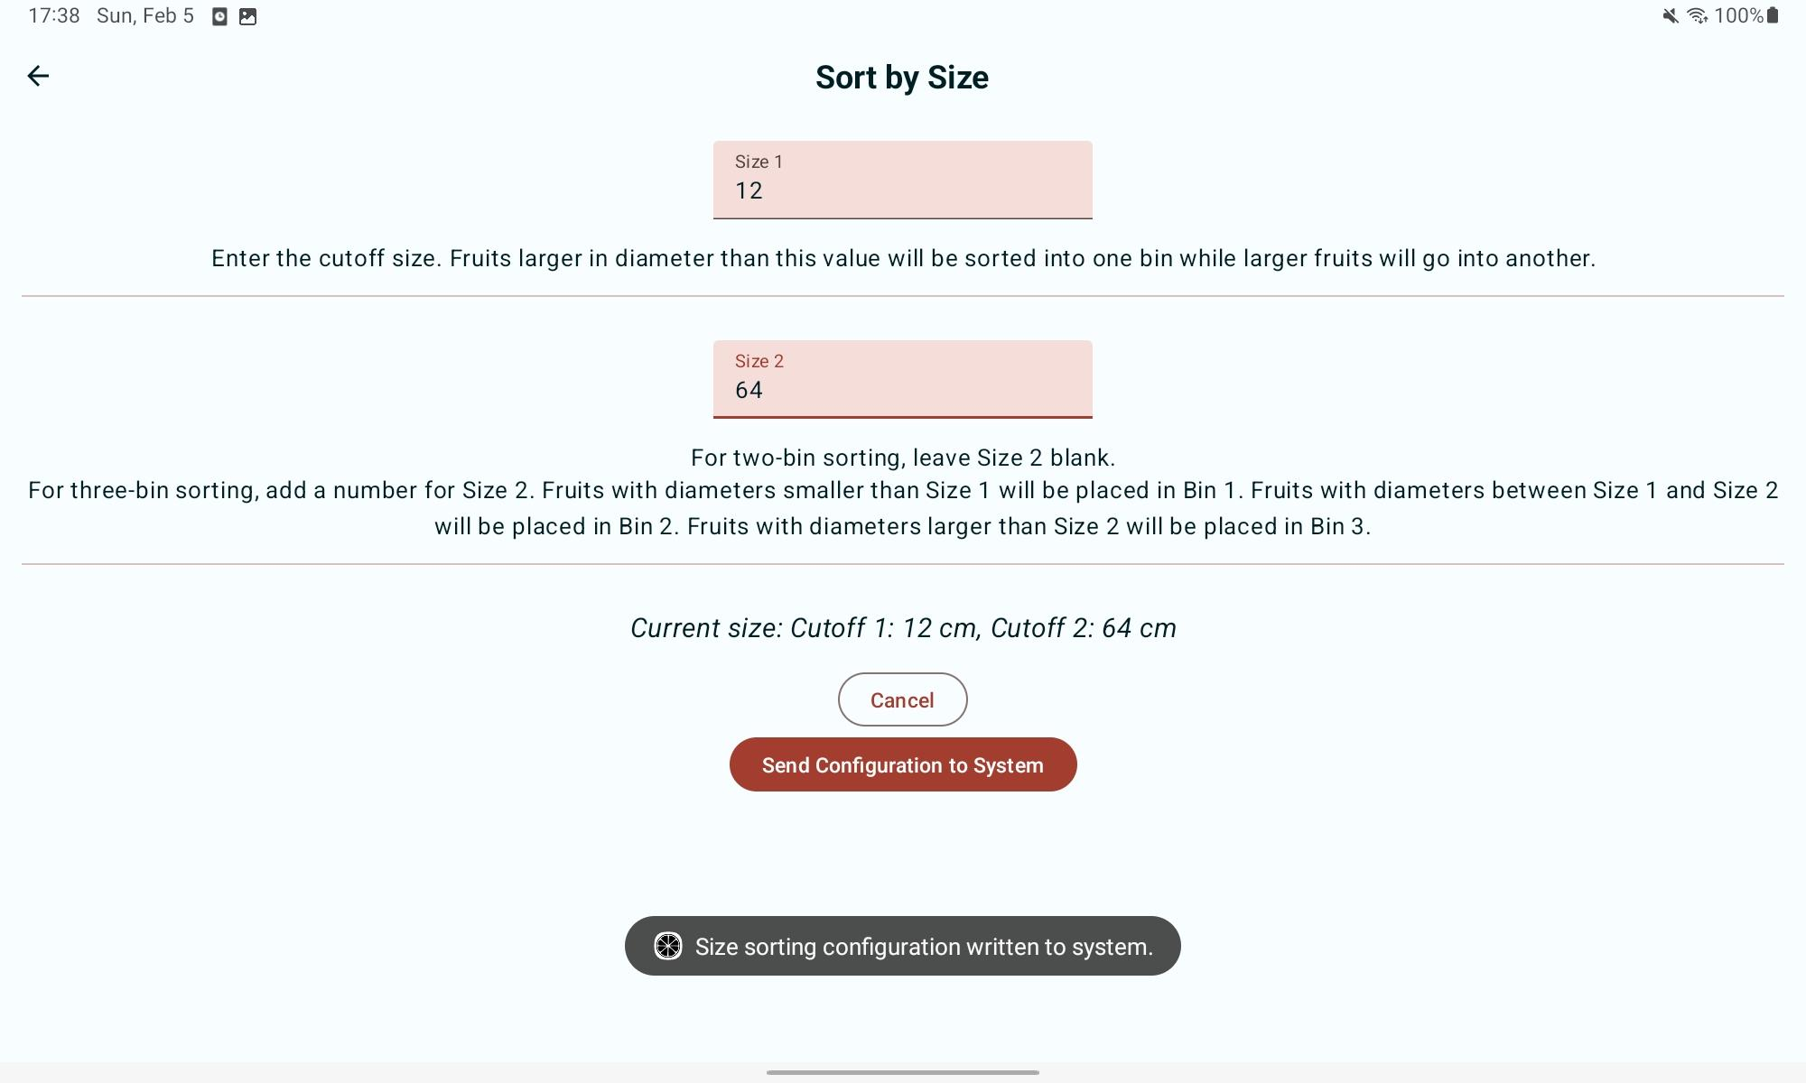
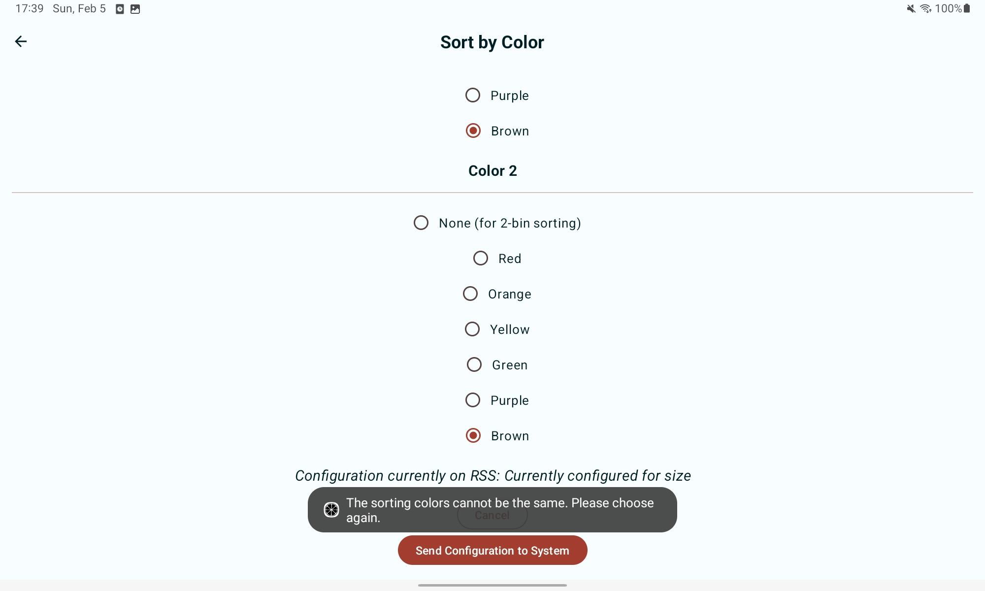
Subsystem 1, Android Application
Notes:
Top left: note new UI, Material 3
Top right: Machine Info screen is much more readable (and has actual values from the BLE server)
Bottom left: Configuration gate prevents application of a nonsense configuration
Bottom right: New sorting screen look w/ confirmation toast

Slide 8
Power, Conveyor Belt & Lever Arm Subsystem
Pace Dominy
Accomplishments since Status Update 1 (17.5 Hours of Effort) | Ongoing progress/problems and plans until the next presentation
Updated PCB Design Ordered New PCB on 1/30/23 Ordered Extra Components for PCB on 1/30/23 Design of Conveyor Belt & Guiding Rails finished in Solidworks Part drawing with cutlist for conveyor belt frame | Solder PCB Validate PCB Determine belt material and sourcing Confirm dimensions with other subsystem (i.e. camera) Enclosures and integration of electrical equipment

Slide 9
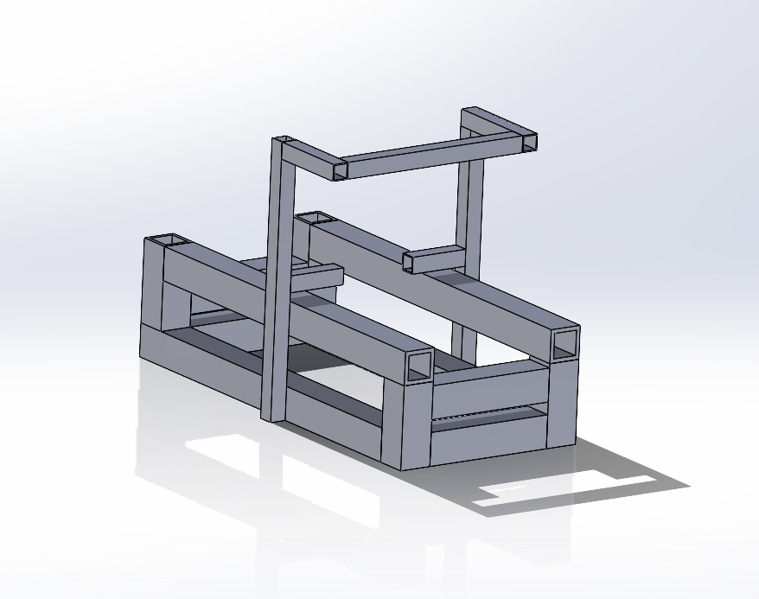
Solidworks Design
Notes:
Used existing weldment profiles to determine appropriate cut lengths for the frame pieces
Going to be made out of wood not tubes

Slide 10
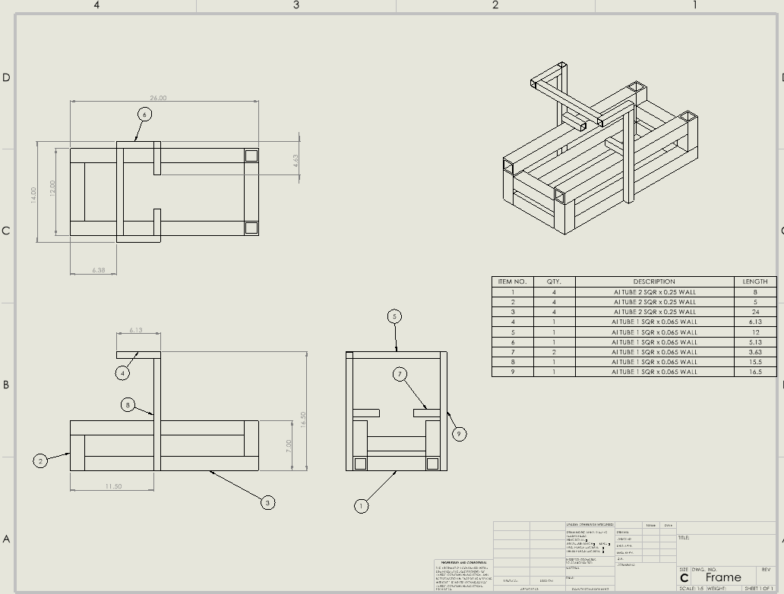
Part Drawing of Frame
Notes:
Building frame to accomodate COTS (Consumer Off The Shelf) instead of having to create hardware
aka not custom pieces

Slide 11
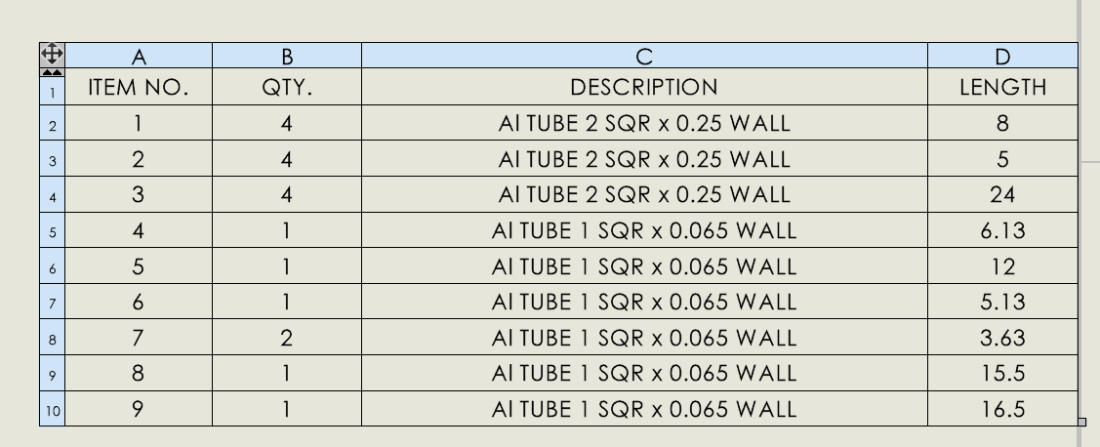
Cutlist For Frame

Slide 12
Subsystem 3, Sensors
Lam Tran
Accomplishments since Status Update 1 (23 hrs of effort) | Ongoing progress/problems and plans until the next presentation
Finished integrating codes to the Raspberry Pi Tested the camera with varying height to determine which height minimize distortions Updated color sensor code Updated the weight sensor code Did some testing of color sensor with objects of varying colors | Tested the color and size sensor with objects of varying sizes and colors with the Raspberry Pi Implement fruit’s scarring/disfigurement detection to the subsystem Tested the weight sensor code with 2 load cells
Notes:
I finished integrating my color and size sensor code to the Rasupberry Pi. I also tested the camera with varying height to determin which height minimize distortions. I also did some updated on the color sensor code and the sensor code. I also did testing of the color sensor with objects of varying colors.
My next plans is to continue to do some more testing on the color and sensor with the Raspberry Pi. Then I will implement scarring/disfigurement detection using the the measurement of the sensor. We did talk to our sponsors, he mentioned using machine learning to do that. but I mostly likely I will just use the clor/size sensor measure to determine that.
Then I will test if my weight sensor cod3e if it could handle 2 load cells

Slide 13
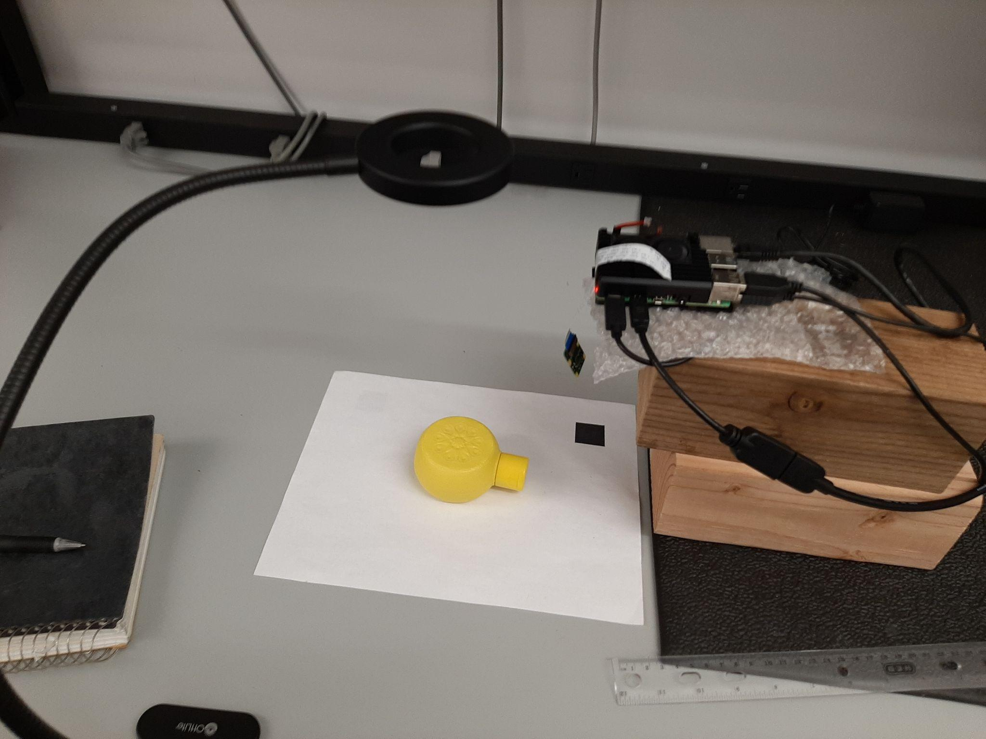
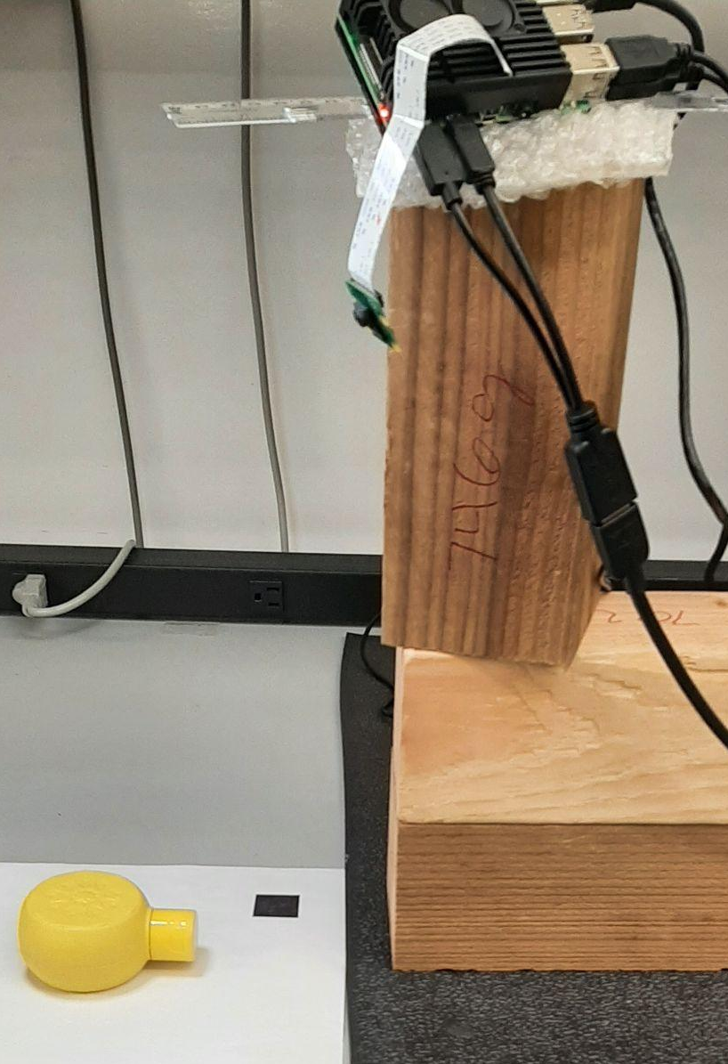
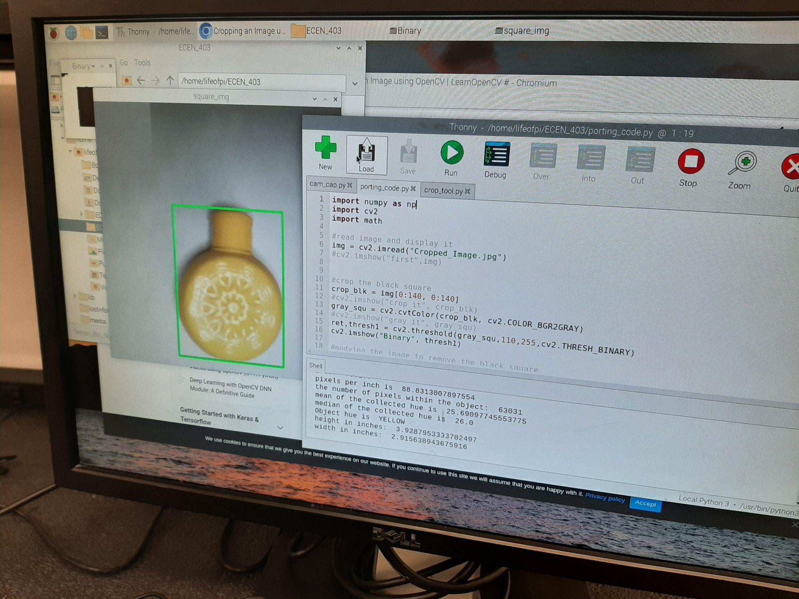
Subsystem 3, Sensor Application
Lam Tran
Notes:
Left pic: the code is integrated to the rasp
Mid pic: Testing to a height, maybe a camera height of 8 inches
Right pic: Testing a height of maybe 19 inches

Slide 14
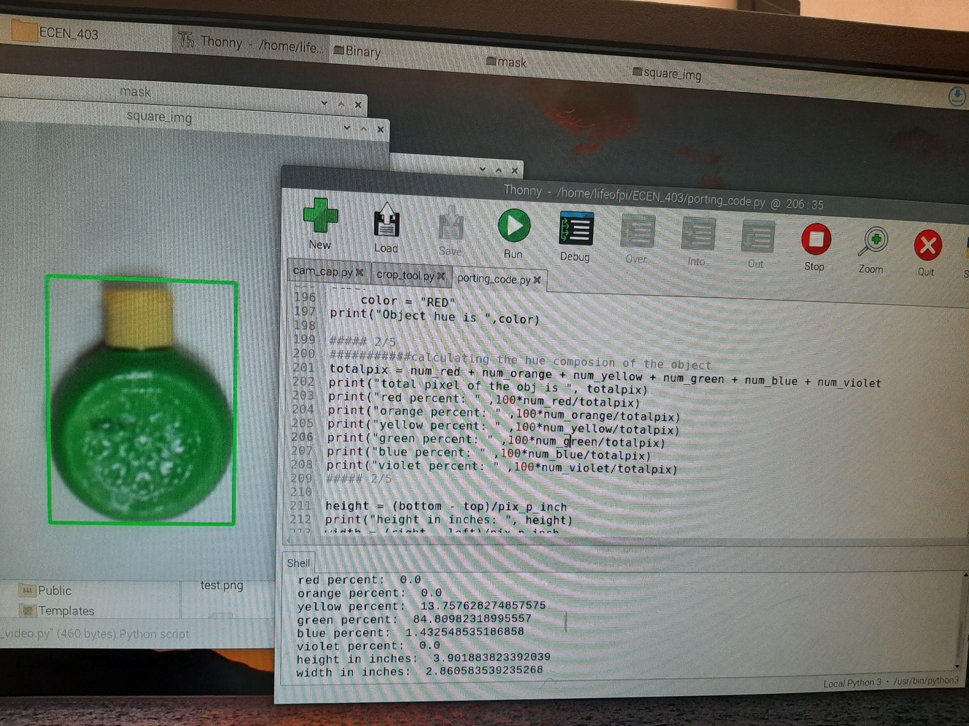
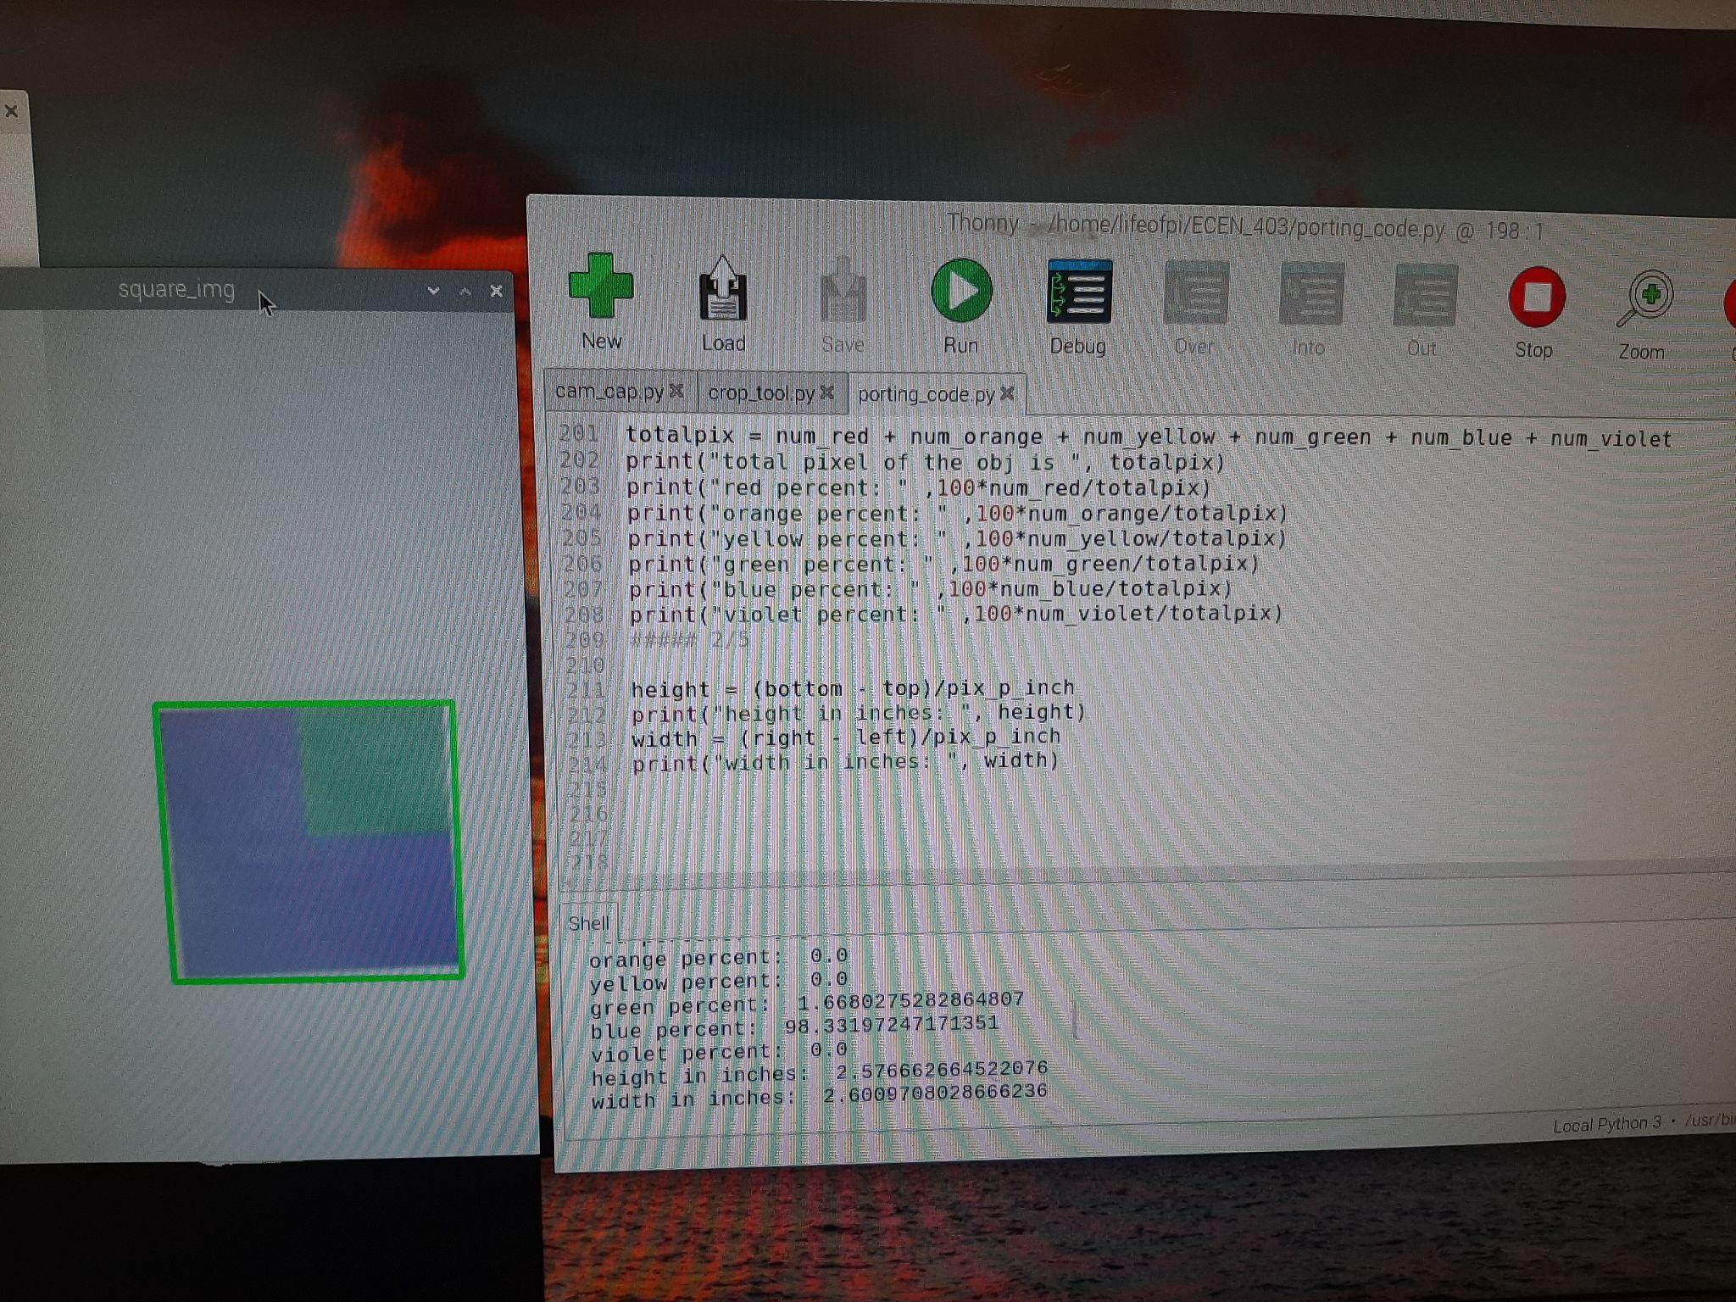
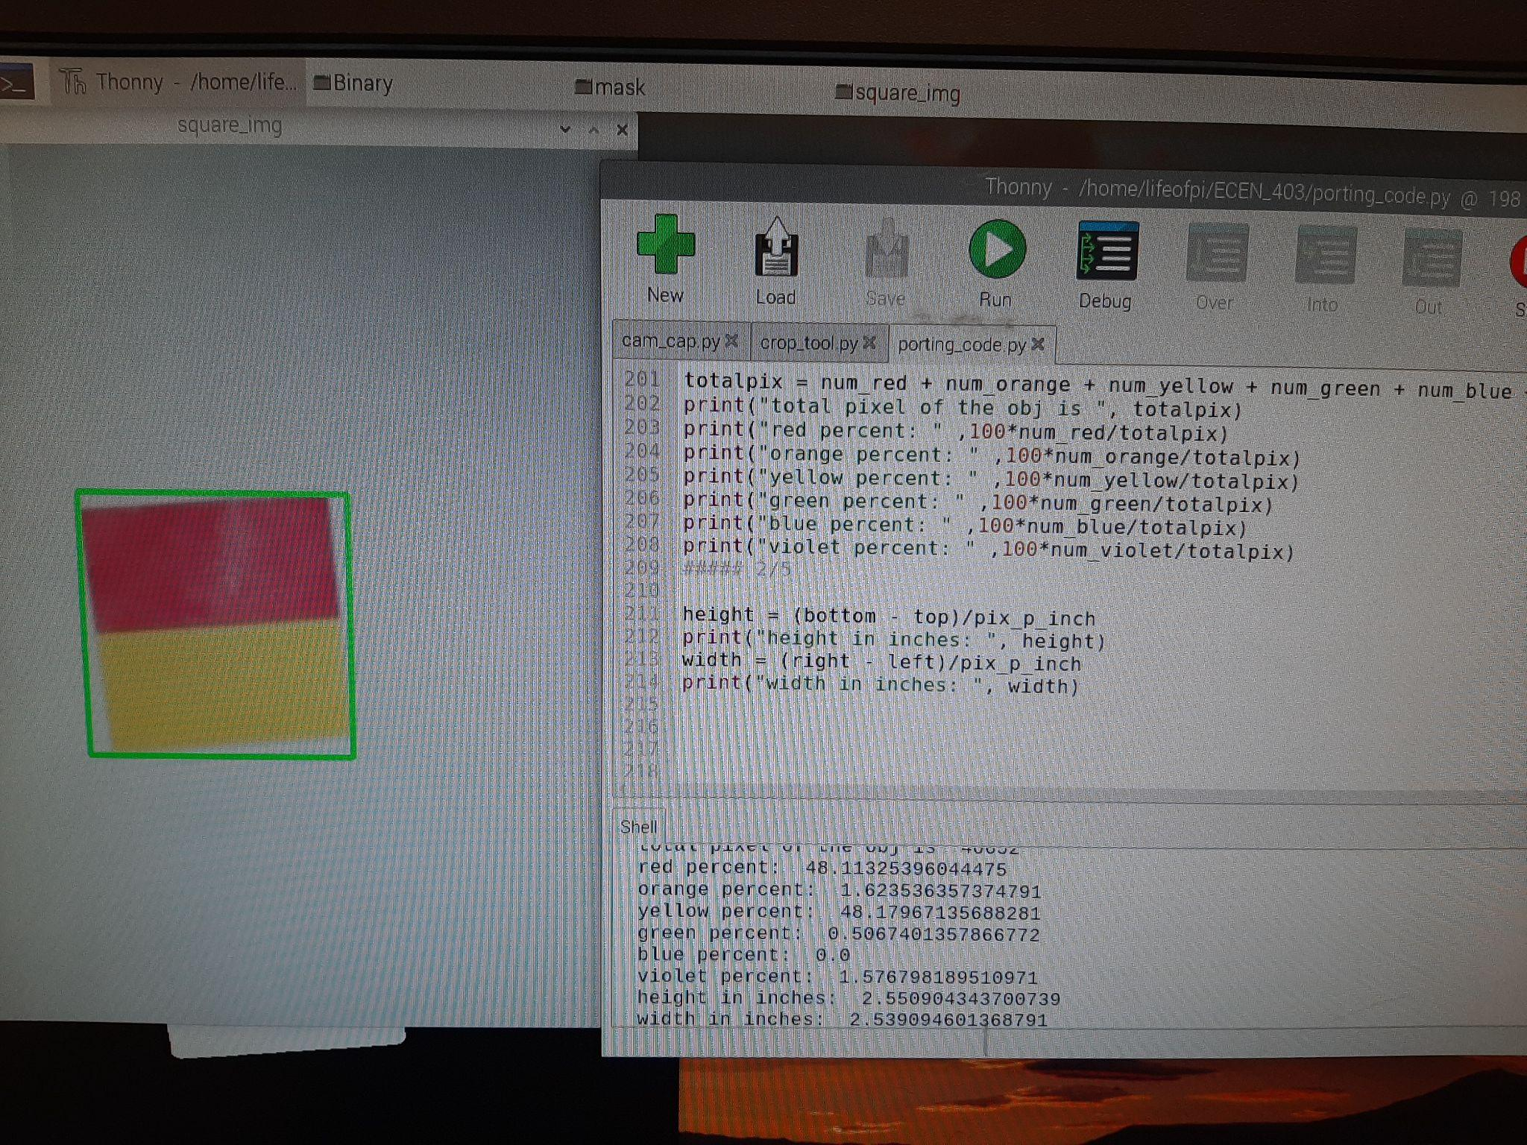
Subsystem 3, Sensor Application
Notes:
I change my the colors sensor code so that takel the color compsitons of obj
14 % yellow, 85% green
48 % red, 48% yellow
weird one, 2% green, and 98% blue, this may be due to the printer being noisy
so more stuff testing

Slide 15
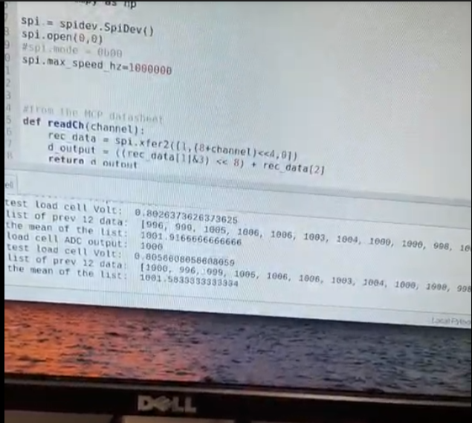
Subsystem 3, Sensor Application
Notes:
Noise affect the out put of the sensor
So I average the last 12 reading, to smooth out the a final result.

Slide 16
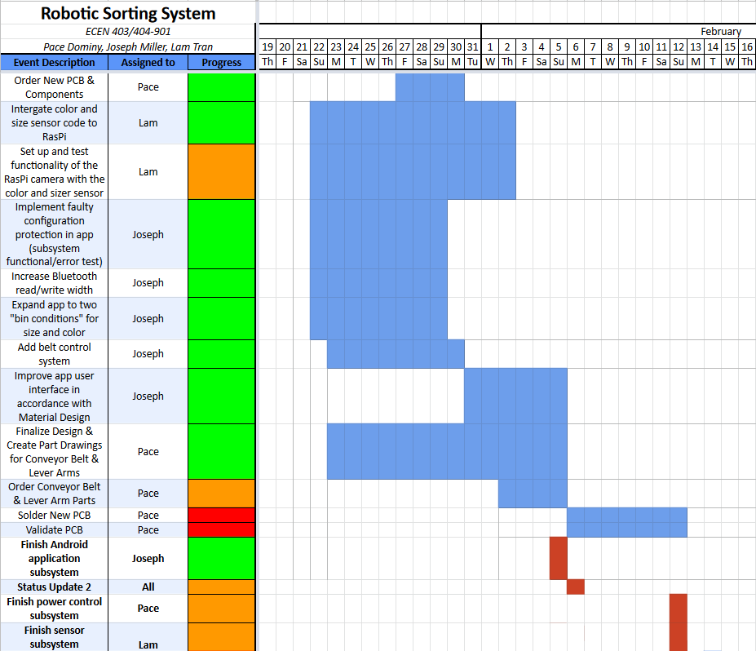
Execution Plan: Recent Progress
Notes:
Recent progress has been putting the final touches on the subsystems – note that our 403 subsystems (all except those related to the physical fabrication of the device) are all scheduled to be finished in the very near future.

Slide 17
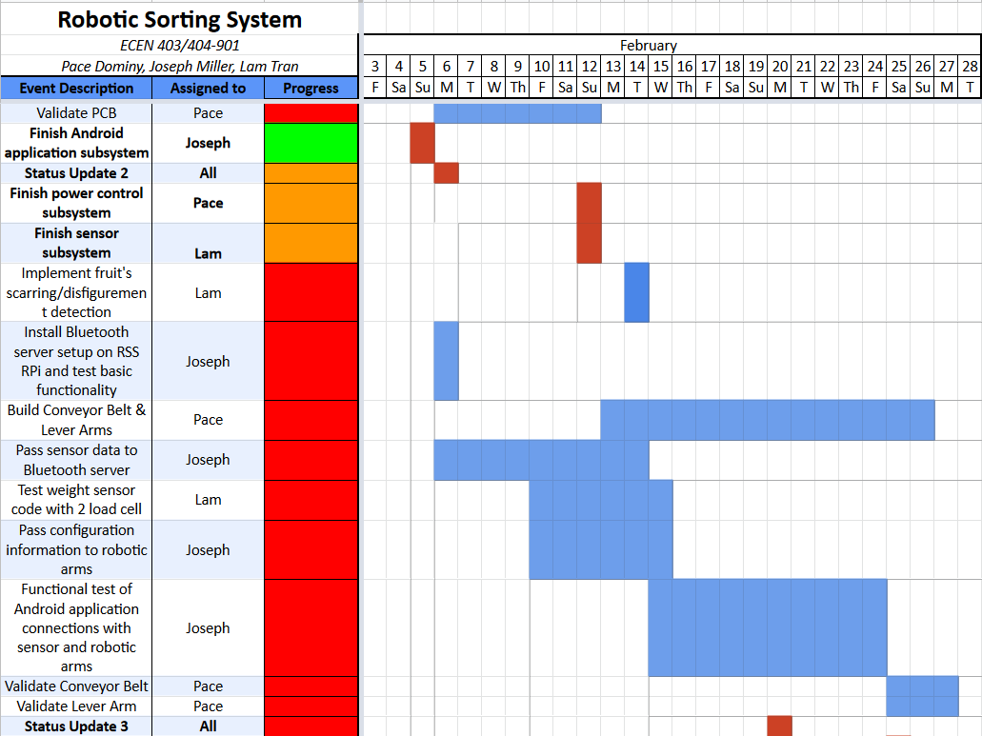
Execution Plan: Upcoming Plans
Notes:
The key upcoming plans are to finish fine-tuning subsystems and to begin the physical construction of the machine.

Slide 18
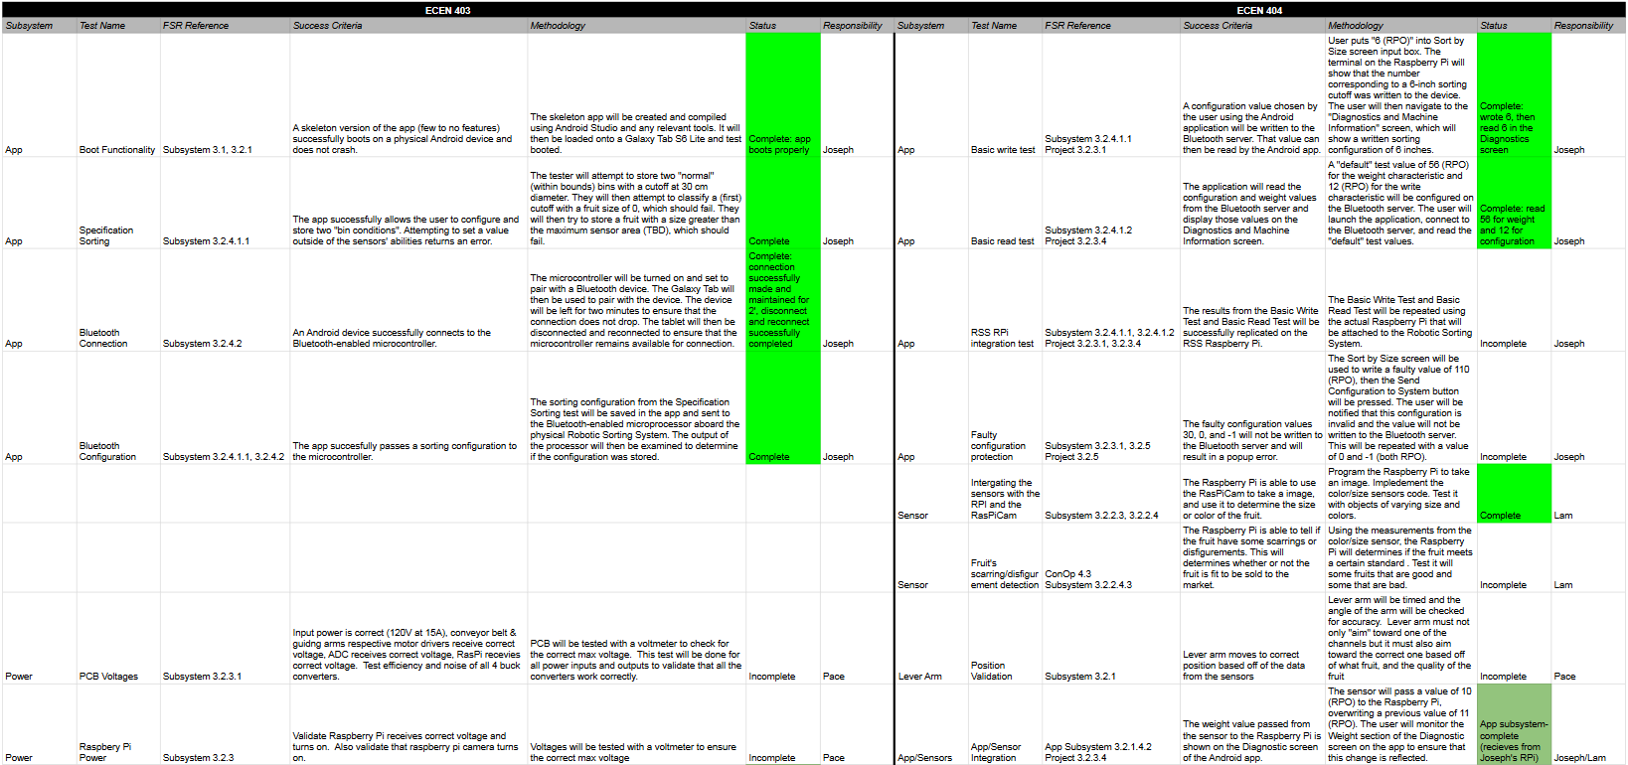
Validation Plan (part 1)
Notes:
Key thing to note is that the subsystem-specific validations are becoming closer to either complete or subsystem-complete

Slide 19
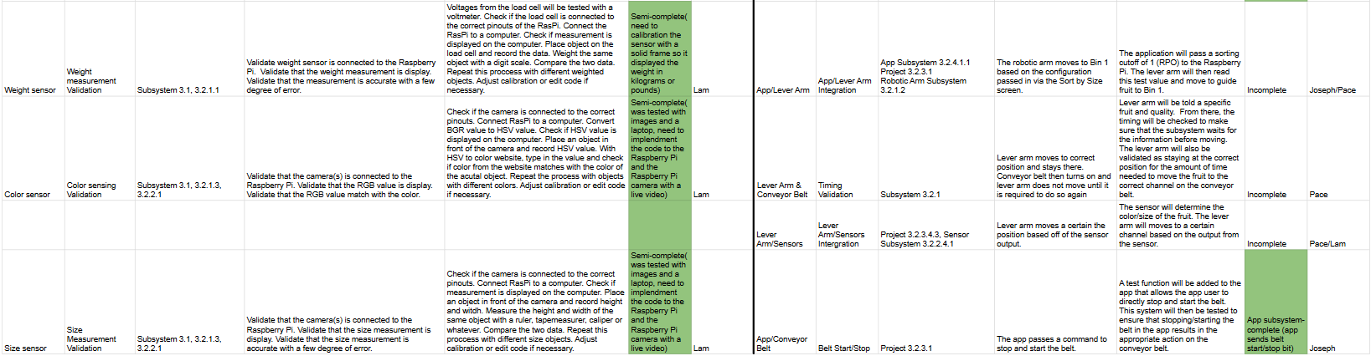
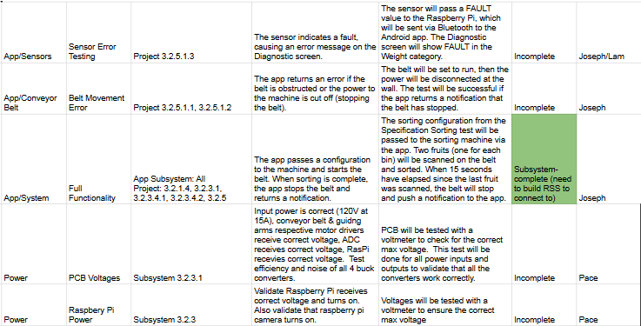
Validation Plan (part 2)

Slide 20
Thank you!

